Slide 1
Trends in Healthcare/Nursing Informatics
NURS 737: Nursing Informatics Concepts and Practice in System Adoption
Module 9, Topic 1
This document is intended solely for the use of N737. Not for distribution

Slide 2
Content
Digital Health
Artificial intelligence / Data analytics (Predictive modeling)
Population Health /Social Determinants of Health
Cybersecurity issues
Management health IT during the Pandemic
2

Slide 3
Digital Health

Slide 4
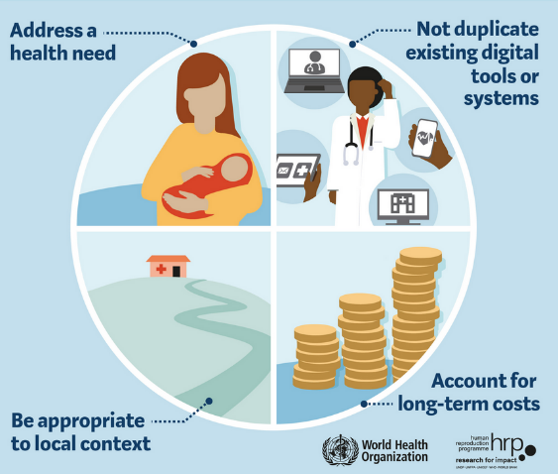
Digital Health
The scope of digital health includes categories such as mobile health (mHealth), health information technology, wearable devices, telehealth, and personalized medicine.
Digital health technologies use computing platforms, connectivity, software, and sensors for health care and related uses.
Notes:
https://www.fda.gov/medical-devices/digital-health-center-excellence/what-digital-health

Slide 5
Digital Health Technologies
Telemedicine/TelehealthPatient portals
Mobile health apps
Wearable devices
GIS systems with dashboards
Examples: COVID-19 infection rates
Public health social networking sites
Online support groups

Slide 6
Artificial intelligence and Predictive modeling

Slide 7

Artificial Intelligence
“AI is a large field of transdisciplinary science. The scientific disciplines that underlie AI include logic, statistics, cognitive psychology, decision theory, neuroscience, linguistics, cybernetics, and computer engineering.” (Howard, 2019)
AI train machine to think like a human, which requires a large volume of data.
Examples: IBM Watson, clinical
decision support programs

Slide 8
Healthcare Data Analytics
Analytics helps use data to make healthcare and business decisions.
Analytic programs apply statistics, formulas, modeling, and present findings with visual analytical tools such as score cards and dashboards.
Analytics can be categorized into the decision support systems (DSS).
Analytics may be descriptive, predictive, or prescriptive.

Slide 9

Predictive Business Intelligence
At the predictive level, statistical techniques are used to explore typically large volumes of data to discover key correlations or causal relations
➔ To determine what
might happen
Notes:
Let’s look into predictive BI.
At the predictive level,

Slide 10
Predictive Modeling
Used in predictive analytics to create a statistical model of future behavior.
Predictive analytics:
Analyzing large volumes of data to derive meaningful business and clinical insights.
These insights are typically correlations or relationships (A is related to B) rather than causality (A caused B).
Example: Online retailers predict that “customers who bought item A are likely buy item B.”

Slide 11
Population Health & Social Determinants of Health

Slide 12
Population Health and Population Health Informatics
Population Health
Comprises organized activities for assessing and improving health and well-being of a defined population.
Population Health Informatics
the systematic application of information technologies and electronic information to the improvement of the health and well-being of a defined community or other target population.

Slide 13
Overlap of Population Health and Health Informatics
Medical Care/Clinical Services
Population/
Public Health Services
Health Informatics/
Information Sciences

Slide 14

Social Determinants of Public Health
Social determinants of health are defined as conditions in the environment in which people are born, live, learn, work, play, worship, and age that affect a wide range of health.
(Healthy People 2020).

Slide 15
Social Determinants
Economic Stability:
Poverty, employment, food Security, housing Stability
Education
High school graduations, enrollment in higher education, language and literacy, early childhood education
3. Social and Community Context
Social cohesion, civic participation, discrimination
4. Health and Health Care
Access to health care, access to primary care, health literacy
5. Neighborhood and Built Environment
Access to healthy foods, quality of housing, crime and violence, environmental conditions

Slide 16
Informatics Applications for Measuring Population Health
The following content in this module was developed by the office of National Coordinator for Health Information Technology.

Slide 17
Population Health Data Types
Common data types: conventional data types that are often extracted from traditional data sources.
Medical insurance claims: demographics, diagnoses, procedures, cost.
Medication insurance claims: medications, cost.
Health Risk Assessment (HRA), Active Daily Living (ADL), and other surveys: various data types.

Slide 18
Population Health Data Types
Common data types (cont.):
Demographics (e.g., age, sex, gender).
Diagnoses (e.g., diagnosis, severity).
Medications (e.g., prescription, dispense).
Procedures (e.g., inpatient, outpatient).
Surveys (e.g., Health Risk Assessment or HRA, Patient Health Questionnaire version 9 or PHQ-9).
Utilization (e.g., cost, hospitalization).
Grouper variables (e.g., advanced clinical groups or ACGs, diagnosis-related groups or DRGs).

Slide 19


Population Health Data Types
Emerging data types: New types of data that are acquired from nontraditional sources and which are gradually becoming mainstream.
Electronic Health Records: diagnoses history, lab values, vital signs.
Health Information Exchanges: admission, discharge, and transmission records.

Slide 20
Emerging Data Types (cont.)
Emerging data types (cont.)
Lab orders and values (e.g., HbA1c).
Vital signs (e.g., body mass index or BMI, blood pressure).
Social data (e.g., income levels).
Patient-generated data (e.g., mobile health or mHealth, patient-reported outcomes or PROs).
Other data (e.g., workflow data).

Slide 21
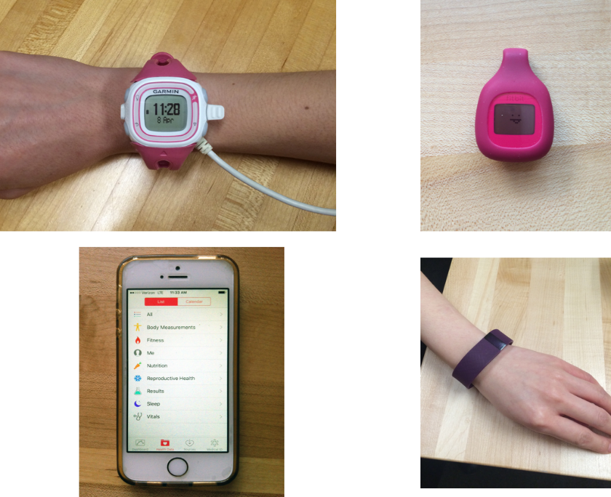
Emerging Data: Patient-Generated Data
Center for Teaching and Learning, Bloomberg School of Public Health, Johns Hopkins University. (2016). CC-BY NC SA 4.0.

Slide 22
Emerging Data Types: EHR Data
Advantages of EHR data:
Includes unique data types, such as lab values, vital signs, social data, problem list, and others.
Includes procedures and Rx that are not covered by insurance (e.g., over-the-counter medications).
Includes both insured and uninsured patients.
Disadvantages of EHR data:
Usually includes data collected by one provider entity and does not include data collected elsewhere.
Often has a lower consistency across different data providers, especially considering the free text.
Large-scale EHR datasets that cover large populations are uncommon.

Slide 23
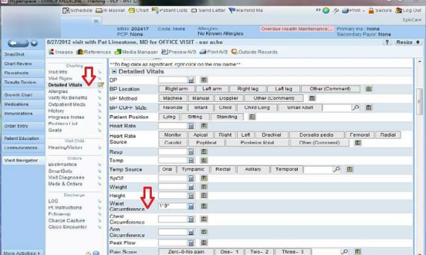
Emerging Data Types: EHR Data
Potential population health data types:
Demographics
Diagnoses and problem lists
Procedures
Prescriptions (medications)
Family and social histories
Vital signs
Immunization records
Surveys and patient-reported outcomes
Additional meta-data and free-text notes/reports

Slide 24

Emerging Data Types: Registries
Types of registries:
Local EHR-based registries
(e.g., a hospital-level registry to
identify patients with a certain condition/need/risk)
Clinical trial and condition-based registries (e.g., often funded federally or by nonprofit associations)
Public health registries (e.g., often limited to geographical boundaries)
National reporting registries (e.g., CDC, FDA, or NIH-led registries)

Slide 25
Other Data Types Captured by IT Systems
Workflow data types (e.g., care intensity, type of provider, place of admission/discharge)
Environmental data (e.g., GIS-bound environmental data, such as ratio of fast food restaurants to fresh food grocery stores)
Marketing data (e.g., shopping behaviors, bankruptcy records, credit scores)
Ethical and legal questions are still unanswered if certain data types can/should be used for population health stratification
Notes:
.

Slide 26
Management health IT during the Pandemic

Slide 27
Content
Background
Policies and Procedures a During Pandemic
Workflow and HIT System Changes
Analytics and Predicative Modeling
Health Information Exchange (HIE)
Telework
Summary
27

Slide 28
Background

Slide 29

Background
The World Health Organization (WHO) defines a pandemic as the “worldwide spread of a new disease” (WHO, 2010).
Some examples of these pandemics are:
H1N1 Smallpox Spanish flu | SARS MERS COVID-19
29

Slide 30

Background: COVID-19
Caused by the SARS-CoV-2 virus, which was first diagnosed in Wuhan, China
Declared a pandemic by the WHO on March 11, 2020
First case in the U.S. on February 27, 2020
The number of total cases in the U.S. surpassed 29.9 million infections and 526,000 deaths on March 9, 2021
First US person received the COVID-19 vaccine on December 14, 2020
30

Slide 31

Policies and Procedures During Pandemic

Slide 32
Changes in Policies and Procedures
Policies and procedures may need to temporarily change to meet the organization’s needs.
New policies and procedures will need to be developed, such as:
Activation of emergency preparedness informatics team(s), initiation of incident command center, staffing policies, hospital overcrowding and updated Personal protective equipment (PPE) procedures

Slide 33
Activation of Emergency Preparedness Informatics Team(s)
Emergency Preparedness Informatics team should be prepared for the following:
Data surveillance for patients and clinical staff with disease specific symptoms
Communication with local, state, and federal agencies regarding data reporting, surveillance and CDC recommendations
Pandemic training to educate and protect staff and patients
Accommodation of urge in informational technology capacity to sustain healthcare delivery

Slide 34

Emergency Preparedness Informatics Teams (Cont.)
Development of electronic forms/tools, such as screen forms, pandemic-related orders and test results forms and quarantine discernment alerts
Implementation of downtime procedures if EMR is unavailable such as paper documentation
Other pandemic-related tasks as needed

Slide 35

Initiation of Incident Command Center
One centralized location to receive up-to-date information
The incident command center include various roles, including:
System Incident Commander Logistics Chief IT Incident Commander/ Informatics Nurse Specialist | Operations Chief Planning Chief Financial/Admin Chief

Slide 36
Incident Command Center (Cont.)
The incident command center tracks real-time information on any outbreak, monitor and maintain essential supplies.
The INS helps develop a standard approach to identify, categorize and track various data.
Typical benchmark items to be reported to state officials:
Total number and current utilization of negative pressure rooms, hospital beds, ICU beds, ventilators, etc.
Test results: daily numbers of positive, negative, and persons under investigation

Slide 37
Shifting Priorities
The INS will encounter significant changes in their daily job functions during a pandemic.
INSs can expect to be involved in activities that are not part of their routine job responsibilities:
Preparing to assist the Infection Control department in the logistics of disseminating information to staff.
Disseminating and/or granting access to pandemic-related EBP literature to staff for most updated guidelines and treatment protocols.
Assisting in the development of emergency staffing float pool positions to cover influx surge of positive pandemic patients.

Slide 38
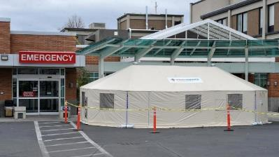
Shifting Priorities (cont.)
INSs can expect to be involved in activities that are not part of their routine responsibilities (cont.):
Open additional facilities to cover patient surge: tented areas outside hospital ERs, convention centers, and repurposing existing units within the hospital.
Creating pandemic-specific documentation workflows, centralizing all clinical assessments and interventions related to the disease in a single user-friendly form and updating it as new clinical recommendations are released

Slide 39

Workflow and HIT System Changes

Slide 40
Changes to Nursing Documentation Workflows
INS should prepare to temporarily suspend certain documentation items that are normally required.
During patient volume surges, have backup workflows in the EHR that show what nurses need to document for essential patient care in a time of crisis.
Minimizing tasks and documentation for nurses is especially critical to meet care demands
Keep documentation templates simple, easy, and user friendly
Stay up to date with any regulatory waivers that may be released by the CMS

Slide 41
EHR To-Do List: Overview
EHR changes will be needed to accommodate changes in patient care and clinician workflows
EHRs must manage increased patient volumes and user activities.
Assess the processing capacity of the EHR by performing routine load tests.
INS should anticipate the needs to:
create new EHR forms
manage change requests
create new login profiles and expand staff access
install any new hardware and software to enhance communication channels between patients and clinicians
expand the exchange of information within the organization as well as with other organizations

Slide 42
EHR To-Do List
Additional forms and clinical order examples
Screening forms: to identify individuals that may be positive
Lab order and results forms: To process disease swab tests and any other pertinent tests, must be added to lab order forms.
Order sets: An order set addressing the specific needs of positive patients and their caregivers
EHR alerts
Quarantine Discernment Alert: An alert for patients that have been tested but have pending results.
Identifier on Patients Information Banner: positive status on patients EHR banner of patient information.

Slide 43
EHR To-Do List
Tracking boards
Include an icon representing that the patient is on isolation/quarantine or positive, which should be visible to all staff.
Disease dashboards
Track positive patients in real- time, including admission, discharges or transfers, number of tests administered per day, lab turnaround times, etc.

Slide 44
EHR To-Do List
Expand nurses’ EHR access to meet staffing demands
During the influx of patients into the hospitals, clinicians from non-essential care may need to work in essential patient care areas to provide relief staffing where patients are overcrowding.
This shift in the work environment will require INSs to make clinical access changes needed for them to assume their new roles

Slide 45
EHR To-Do List
Extend any licensure renewal requirements to accommodate staffing needs
To accommodate influx of patient care, renewal of licensure for staffing can be extended in a grace period defined by the credentialing boards
Remote access for staff teleworking
employees who can telework remotely from home should be given the ability to access intranet and EHR data
Login access for new hires and supplemental staff
Onboarding processes for new hires and supplemental staff must be performed quickly and efficiently
Coding that differentiates from permanent staff needs to be established.

Slide 46
Change Request Management
There should be procedures and processes to manage change requests in EHR
Influx of patients will cause overcrowding. Additional bed spaces will need to be made physically, and within the electronic bed tracking system.
Customized dashboards for overcrowding situations will allow care coordinators to track patients movements in patient surge times.
Dashboard flagging patient risk in relation to outbreak:
e.g., potential, suspect, testing, contaminated, high risk) will be important for staff to easily identify positive patients in their care areas.

Slide 47

Telework

Slide 48
Telework
A survey of the likely-to-be affected staff should be conducted to understand if they are well equipped to work from home.
Users will require need-based training well before the health system is overwhelmed by capacity surge.
Office of Personnel Management offers fundamental training courses for employees and managers (Office of Personnel Management, 2020).

Slide 49
Telework: Specific Considerations
Determine the types of roles that are appropriate for a telework environment.
Establish policies and procedures needed for telework, including information about equipment provided by the organization or personal equipment
Select easy-to-use telework programs or software
Train staff on how to use any selected telework programs
Establish a communication channel for staff to continue working together

Slide 50
Telework: Specific Considerations (cont.)
Ensure all telework channels are secure and communication is encrypted.
Ensure that managers understand policies and procedures and are ready to supervise a team of teleworking staff
Establish telework expectations for response time and productivity.
Establish methods for staff to “clock in” their telework hours.

